Slide 1
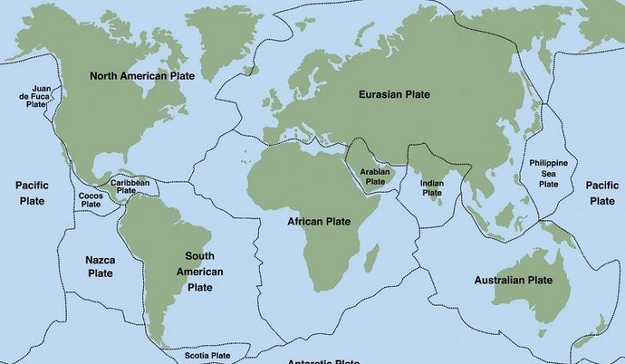
1960-2000 NA Earthquakes

Slide 2




Introduction to the Team
Alicia J.
Angeles S.
Ashlee T.
Asmaa M.
Earthquake research, coding assistance
Earthquake research, coding assistance, presentation screen sharing
Earthquake research, coding assistance, coding screen sharing
Earthquake research, coding assistance, couch potato

Slide 3
Project Goals
Running the code correctly
Producing a presentable graph and slides
Learning about important earthquakes from the past
Learning about how earthquakes occur
Collaborating with peers to work on a presentation and coding project

Slide 4
Background
Northridge, California (January 17, 1994)
6.7 magnitude
7 deaths, 9000 injuries, and $15 billion damage costs
“slip” on a thrust fault
Loma Prieta (July 9, 1989)
4.3 magnitude
62 deaths, 3757 injuries, and <$6 billion damage costs
The result of the movement in the San Andreas Fault
Alaska (March 27, 1964)
9.2 magnitude
131 deaths and $311 million damage costs
Convergent movement
Notes:
The 1994 Northridge earthquake was due to a “slip” on a thrust fault that reaches down to the South-Southwest Northern San Fernando Valley.
The Loma Prieta earthquake of 1989 was a result of the movement in the San Andreas Fault. When the Pacific plates moved away from each other northwestward slipping up to 2 meters apart.
The 1964 Alaska Earthquake was caused by convergent movement of the Pacific and North America plates, the earthquake was a direct result of an oceanic plate sinking under a continental plate.

Slide 5
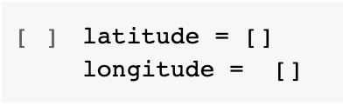
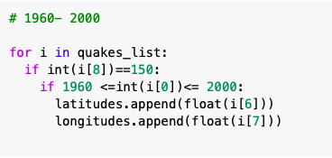
Code to Selecting Data
Empty list for latitude and longitude values
For loops usage
If statement usage
Chose between the years 1960 and 2000
Added floats to the empty list
Region: 150

Slide 6
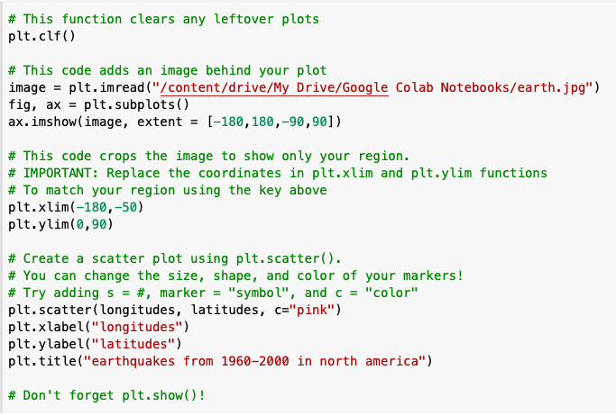
Code to NA Map
Libraries used: matplotlib.plyplot
Table type used: scatter plot
X and Y Labels: longitudes, latitudes
Lists used: longitudes, latitudes

Slide 7
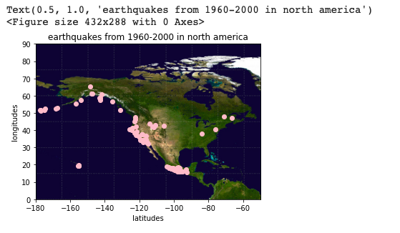
NA Map
101 earthquakes from 1960-2000
Pink markers indicate earthquakes fitting our criteria

Slide 8
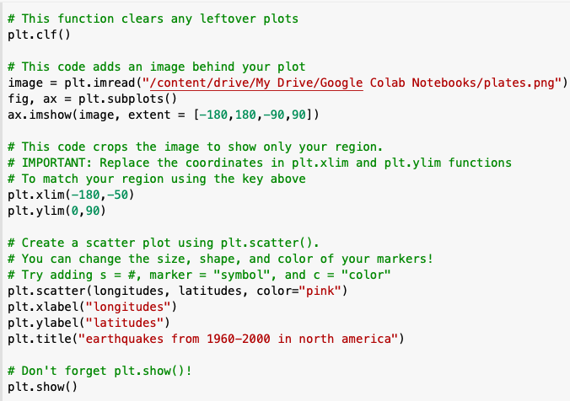
Code to Plates Map
Libraries used: matplotlib.plyplot
Table type used: scatter plot
X and Y Labels: longitudes, latitudes
Lists used: longitudes, latitudes

Slide 9
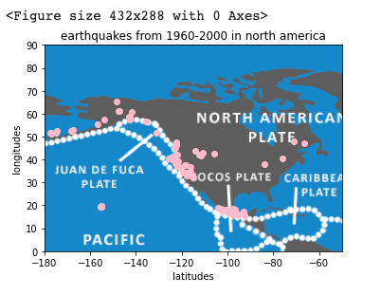
Plates Map
101 earthquakes from 1960-2000
Pink markers indicate earthquakes fitting our criteria
Notes:
The len = 101 different points

Slide 10
Code Challenges & Solutions
Challenge: When importing the files they couldn’t be found
Solution: we traced back to where it was on the drive and refreshed our notebooks
Challenge: The for loop wouldn’t run
Solution: Turn strings into floats
Challenge: uploading the graph picture
Solution: Copy the right path
→

Slide 11
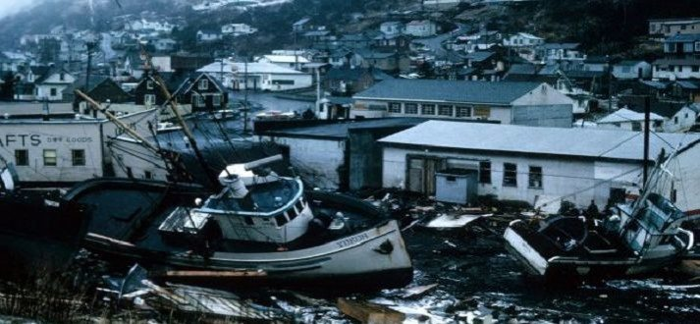
Earthquake Topics
Rebuilding the region
Rebuilding is difficult, but not impossible
1964 Alaska Earthquake took a long time to recover
Are regions affected equally?
California, Hawaii, Western Canada, Mexico are affected by high magnitude earthquakes
New York, Quebec, and western Mexico are mainly unaffected
Notes:
Rebuilding The Region
The North American region past earthquakes have shown that life always comes back and that rebuilding cities is hard but not impossible, while an earthquake such as The 1964 Alaska Earthquake would take a long time to recover from Alaska has and it’s thriving.
Are all regions affected equally?
Places along the North American fault line, like California, Hawaii, and western Canada and Mexico, are affected by high-magnitude earthquakes
Eastern places like New York, Quebec, and western Mexico remain mainly unaffected; this implies that not all communities are affected equally

Slide 12
Conclusions
Takeaways
Before starting get all the needed documents/picture ready
Refer back to notes < talking to each other
3 types of plate boundaries: convergent, divergent, transform
Things we are proud of
Having a presentable graph
Finishing the presentation with a synchronous theme

Slide 13
Next Steps
Things we could work on given more time
Getting rid of the “figure size” on the top of the graph
Changing the marker size and making them more prominent
Doing more research on the earthquakes
In the future
Manage our time better
Establish roles prior to beginning to project

Slide 14
Citations
Northridge Earthquake
Northridge Earthquake
Loma Prieta Earthquake
Loma Prieta Earthquake
The 1964 Alaska Earthquake
The 1964 Alaska Earthquake

